Slide 1
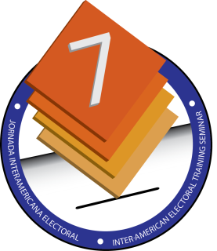
POLITICAL-ELECTORAL PARTICIPATION OF CITIZENS WITH DISABILITIES
Lourdes Soriano
Regional Training Coordinator
September 23
Panamaa

Slide 2
POLITICAL-ELECTORAL PARTICIPATION: EXPERIENCES OF CITIZENS WITH DISABILITIES
Candidates
In our country, people with disabilities are not motivated to participate as candidates to offices elected by popular vote.
We currently have, in the National Assembly, one Alternate Deputy with a hearing disability, now serving his second term.

Slide 3
Electoral participation
Everyone who appears on the voter rolls participates.
The Electoral Court, in advance of elections, implements the General Election Plan (PLAGEL) made up of commissions. Some of these are responsible for taking steps to facilitate voting by persons with disabilities, including the following:

Slide 4
The Program to Update and Purge the Voter Rolls conducts awareness campaigns to encourage persons with disabilities to be identified on voter rolls so they can receive preferential treatment. This is done through:
“YO CUMPLO-CUMPLE TU TAMBIEN” [“I’m Doing My Part – You Do Yours Too”] (Report whether you or a family member has a special condition).
REPÓRTATE [“Check In”] (for preferential treatment at the polling center on election day)

Slide 5
Voter verification (consultation in the field and at the Electoral Court Call Center - CINTE)
Participation in fairs held throughout the country
Updating of information at the Electoral Court (issuance or renewal of ID card, change of residence)
Construction of access ramps at polling centers

Slide 6
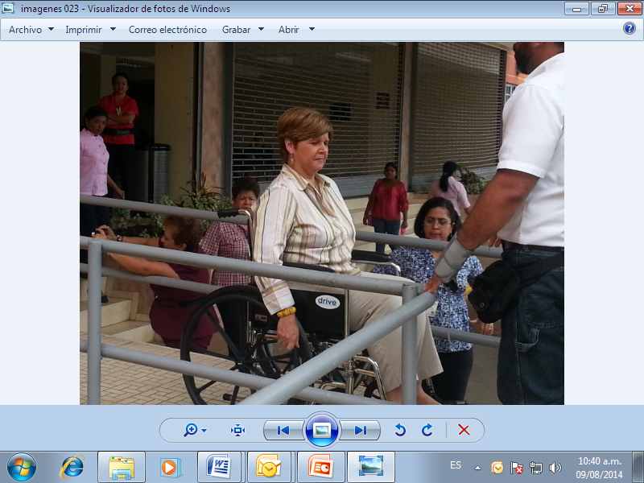
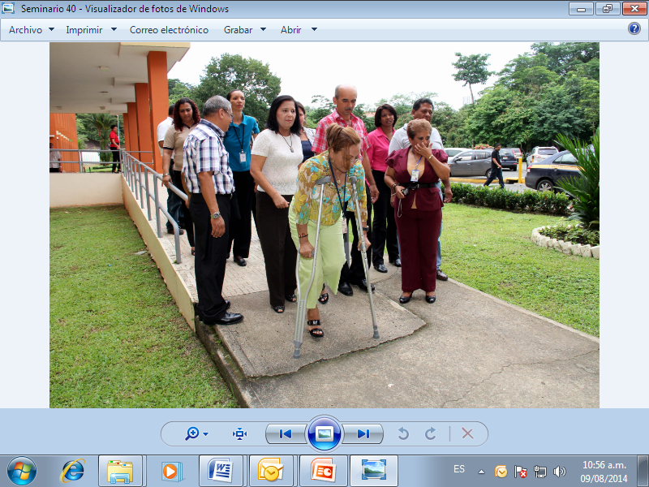
Placement of polling stations where persons with disabilities are identified, on the ground floor of polling centers
Coordination with the National Secretariat for the Disabled (SENADIS), which safeguards the rights of persons with disabilities (training, documentation)

Slide 7
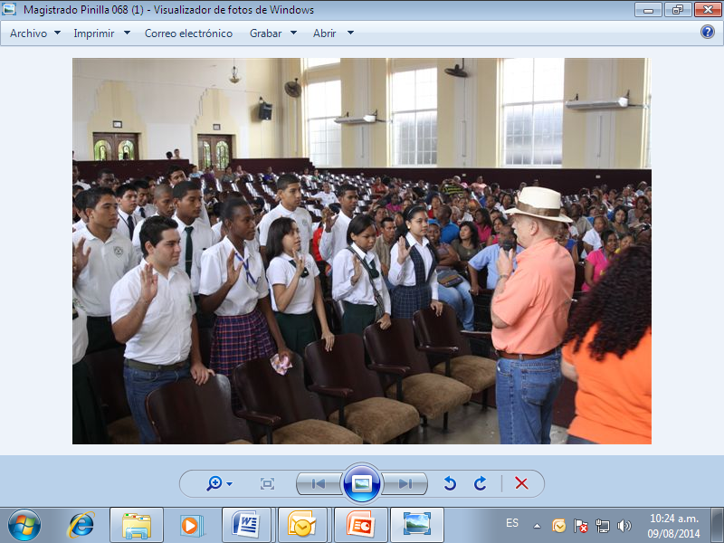
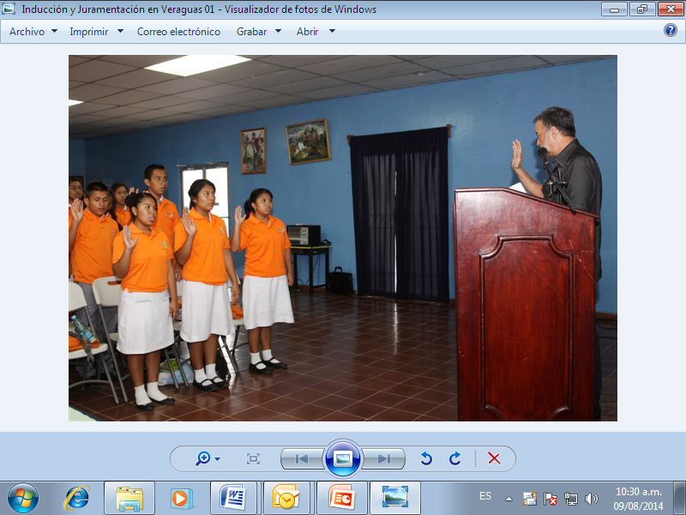
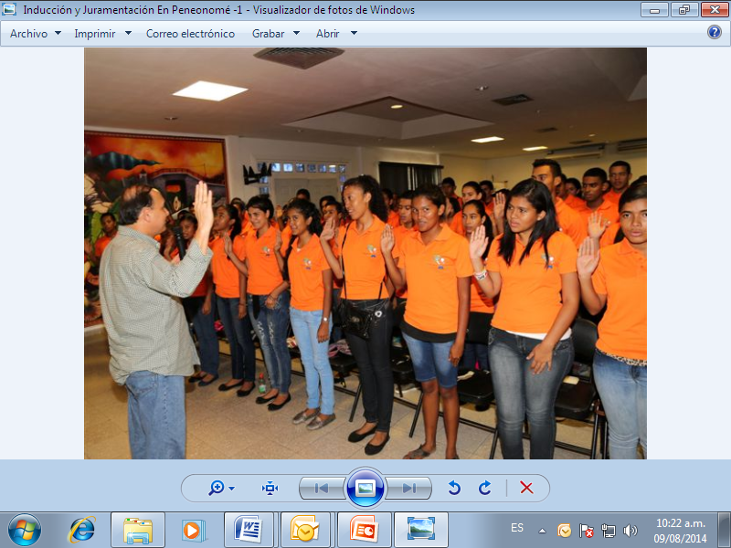
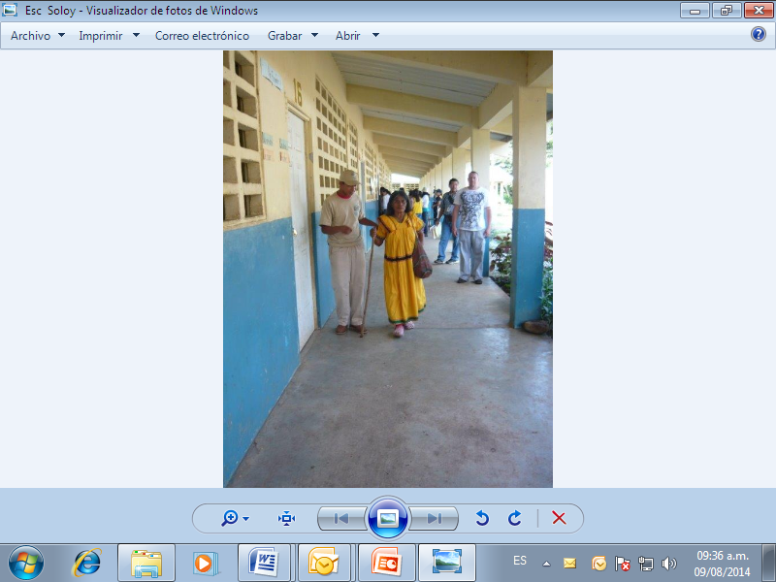
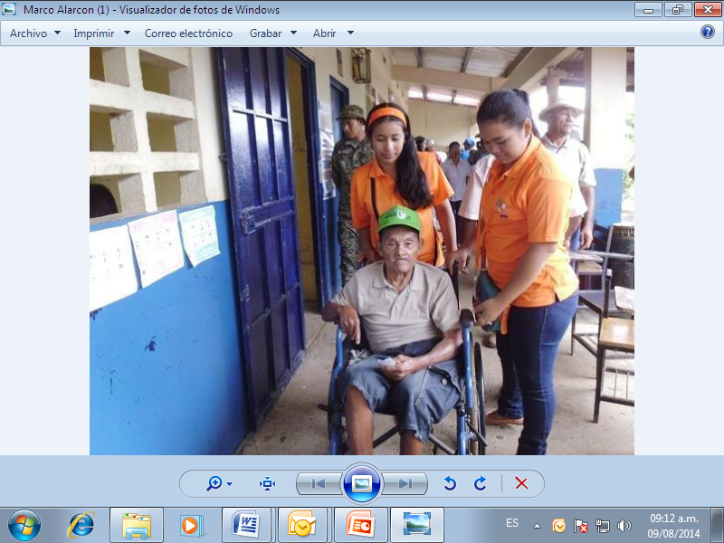
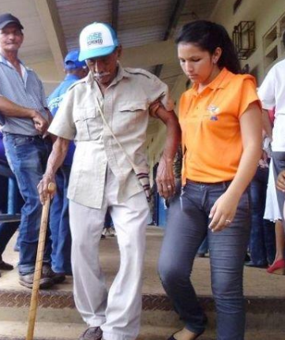
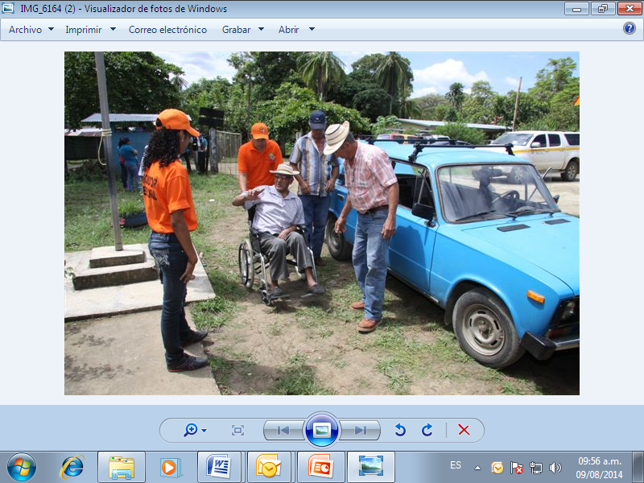
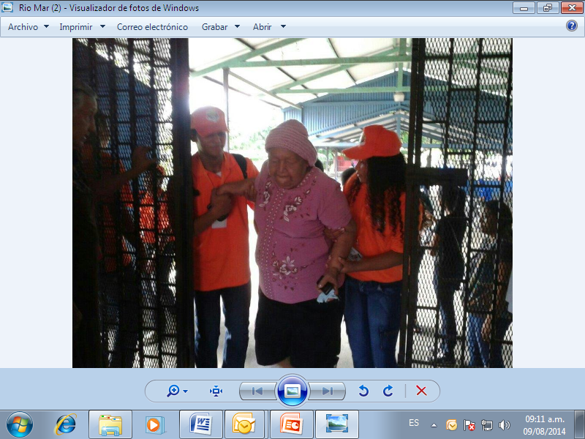
Voter assistants assigned to polling centers on election day

Slide 8
POLITICAL-ELECTORAL PARTICIPATION: EXPERIENCES OF CITIZENS WITH DISABILITIES
Limitations
Low participation of persons with disabilities in political parties.
In the case of persons with visual impairments, equality of opportunities has not been put into practice in the electoral process, as a Braille ballot has not been designed.

Slide 9
POLITICAL-ELECTORAL PARTICIPATION: EXPERIENCES OF CITIZENS WITH DISABILITIES
Limitations
Information was not reaching people who lived in hard-to-access places.
Family members were unaware that they should identify their relatives with disabilities to enable them to participate in the electoral process.

Slide 10
POLITICAL-ELECTORAL PARTICIPATION: EXPERIENCES OF CITIZENS WITH DISABILITIES
Challenges
Develop training projects to encourage leadership among persons with disabilities so that they can participate as candidates to elected office.
Achieve greater voter turnout among persons with disabilities.

